Slide 1



Hawks: A Data Analysis on 3 Different Hawk Species
Julia Cuellar
DSC 680

Slide 2
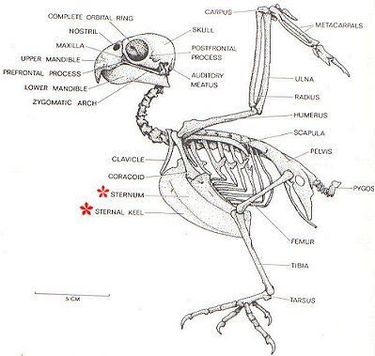
Abstract
Figure 1 Skeleton of Hawk
Hawks are a part of a large group of predatory birds with varying species that include sharp talons and beaks (see Appendix A). At the Cornell College in Mount Vernon, Iowa from the years 1992 through 2003, a study on various measurements on three different hawk species (Cooper’s, Red-tailed, and Sharp-shinned) was performed. A data analysis will be performed on the three different species of hawks based off specific measurements of the winged creature.

Slide 3
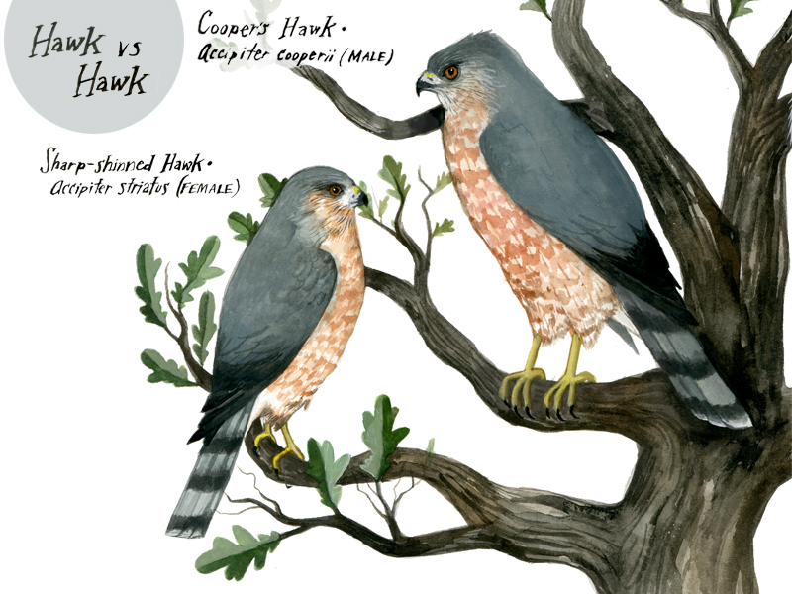
Background
Figure 2 Hawk vs Hawk
A Cooper’s hawk is a medium-sized hawk native to North America that tends to live in wooded habitats and is easily confused with its smaller family member, the Sharp-shinned. The Red-tailed (or ‘Chickenhawk’) is another bird of prey that is located across North America within forest or desert biomes. Lastly, the Sharp-shinned hawk is a small hawk located in North America and is separated into four smaller sub-species.

Slide 4
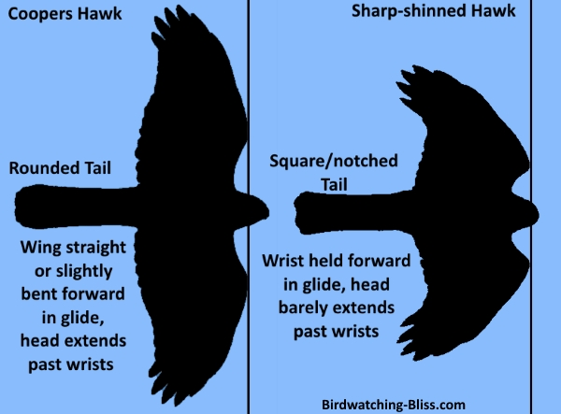
Business Understanding
Figure 3 Cooper’s Hawk & Sharp- shinned Hawk
Hawks are not susceptible to extinction, but they have been prone to be vulnerable to hunting for game as well as have gathered predators against them such as larger birds of prey, red foxes, or racoons (see Appendix B). A data analysis will be performed upon three different hawk species (Cooper’s, Red-tailed, and Sharp-shinned) to determine which measurements contribute to the survival of the winged animal.

Slide 5
Data Understanding - Hawks
A data frame with 908 observations on 19 variables.
Month | 8=September to 12=December
Day | Date in the month
Year | Year: 1992-2003
CaptureTime | Time of capture (HH:MM)
ReleaseTime | Time of release (HH:MM)
BandNumber | ID band code
Species | CH=Cooper's, RT=Red-tailed, SS=Sharp-Shinned
Age | A=Adult or I=Immature
Sex | F=Female or M=Male
Wing | Length (in mm) of primary wing feather from tip to wrist it attaches to
Weight | Body weight (in gm)
Culmen | Length (in mm) of the upper bill from the tip to where it bumps into the fleshy part of the bird
Hallux | Length (in mm) of the killing talon
Tail | Measurement (in mm) related to the length of the tail (invented at the MacBride Raptor Center)
StandardTail | Standard measurement of tail length (in mm)
Tarsus | Length of the basic foot bone (in mm)
WingPitFat | Amount of fat in the wing pit
KeelFat | Amount of fat on the breastbone (measured by feel
Crop | Amount of material in the crop, coded from 1=full to 0=empty

Slide 6
Data Understanding – Hawks cont.
(Head)
## X Month Day Year CaptureTime ReleaseTime BandNumber Species Age Sex Wing
## 1 1 9 19 1992 13:30 877-76317 RT I 385
## 2 2 9 22 1992 10:30 877-76318 RT I 376
## 3 3 9 23 1992 12:45 877-76319 RT I 381
## 4 4 9 23 1992 10:50 745-49508 CH I F 265
## 5 5 9 27 1992 11:15 1253-98801 SS I F 205
## 6 6 9 28 1992 11:25 1207-55910 RT I 412
## Weight Culmen Hallux Tail StandardTail Tarsus WingPitFat KeelFat Crop
## 1 920 25.7 30.1 219 NA NA NA NA NA
## 2 930 NA NA 221 NA NA NA NA NA
## 3 990 26.7 31.3 235 NA NA NA NA NA
## 4 470 18.7 23.5 220 NA NA NA NA NA
## 5 170 12.5 14.3 157 NA NA NA NA NA
## 6 1090 28.5 32.2 230 NA NA NA NA NA

Slide 7
Data Preparation
Due to the fact that this data is supplied from a R repository, there is no Nulls, but there is missing values as well as NaN’s, thus the only data manipulation will be replacing those NaN’s.

Slide 8
Business Questions
Which species of hawks grew to maturity (adulthood)?
Which species of hawks migrated south in the month of November?
Which species of hawks has a lengthier hallux (killing talon)?
Does the time of capture have anything to do with the maturity of the species of hawks?

Slide 9
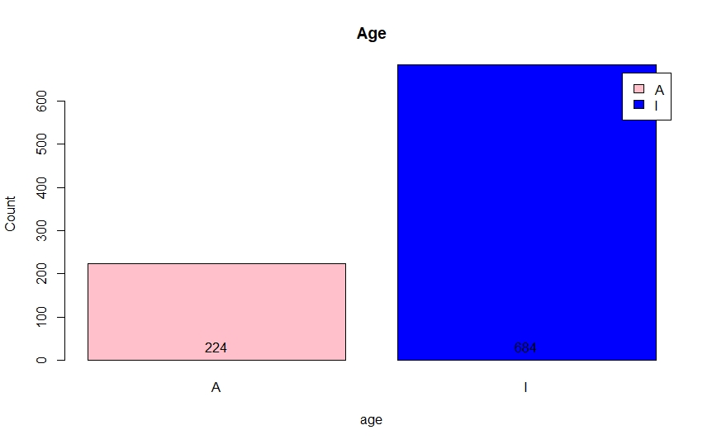
Age
Bar chart of the age of a hawk
A bar chart was made for the age variable based off the hawks data set; there is more immature hawks rather than adult.

Slide 10
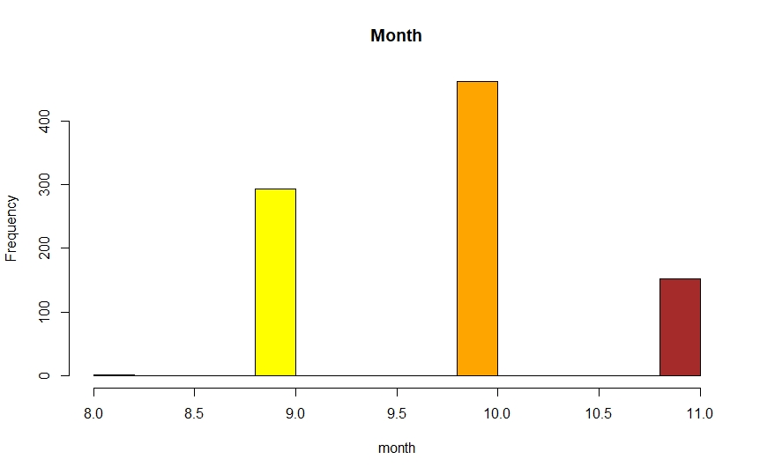
Month
Bar chart of the month of a hawk
A bar chart was made for the month variable based off the hawks data set; there is more hawks present in the month of October compared to others.

Slide 11
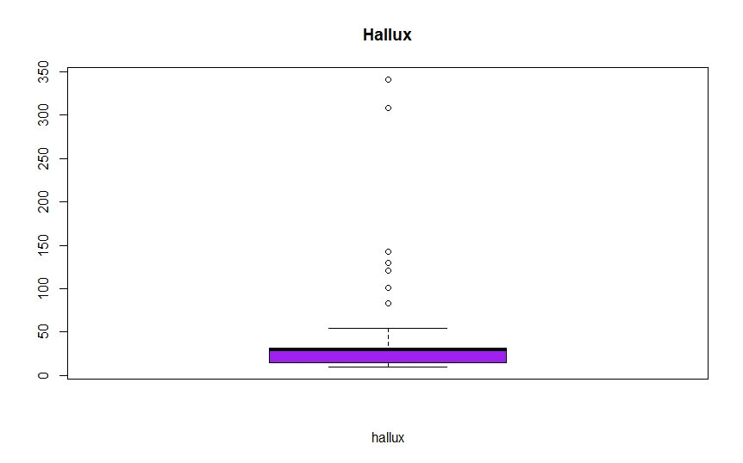
Hallux
Box plot of the hallux of a hawk
A boxplot was made for the hallux variable based off the hawks data set; there is outliers which will still be included (i.e., not removed from the original dataset).

Slide 12
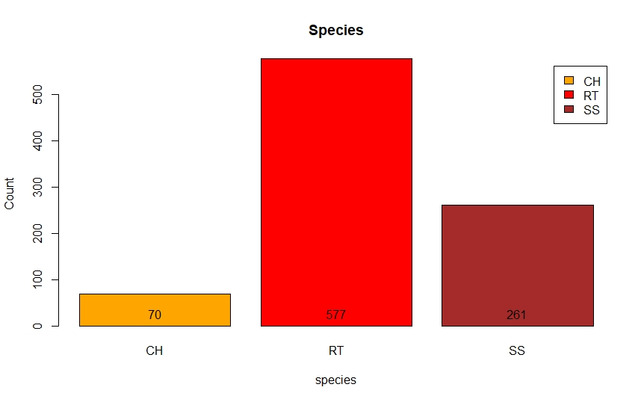
Species
Bar chart of the species of a hawk
A bar chart was made for the species variable based off the hawks data set; there is more red-tailed hawks compared to others.

Slide 13
Assumptions
A Red-tailed hawk is the most species recorded, hence, will be the species to grow to maturity the most.
Due to the Sharp-shinned hawk being identified from Cornell Lab of Ornithology for being the hawk to migrate the most in November, this hawk will be the most to take part in migration in the month of November.
Due to the Red-tailed hawk being the largest out of the three hawk species recorded, it will have a lengthier hallux (or killing talon).
If a hawk is immature, then it will tend to be captured more during afternoon times along with a Red-tailed hawk being the most prominent out of the three.
Upon performing exploratory data analysis (or EDA) with bar charts and a boxplot as well as removing the NaN’s in the hallux variable column when considering the business questions, the red-tailed hawk will probably be the species of hawk that will take for the first three business questions but may fall through for maturity during capture time.

Slide 14
Modeling/Methods
To perform this data analysis of the varying specific measurements, clustering models will be built for age, month, and hallux versus the species of hawks while a regression model will be built on capture time, age, & species of hawks versus the hallux.

Slide 15
Deployment/Results
After building clustering models for age, month, and hallux versus the species of hawks as well as a regression model for capture time, age, & species of hawks versus the hallux, a performance check on the models will be executed to deliberate whether these models correspond to the hypotheses.

Slide 16
Deployment/Results cont.
Cross table of species of hawks vs age
A cross table was ultimately utilized for the species of hawks versus the age of a hawk which concluded that a Red-tailed hawk is the most out of the three species of hawks that grew to maturity or better known as adulthood. There is no performance on the cross table as it is not a model.
Species | Adult | Immature | Total
Cooper’s | 32 | 38 | 70
Red-tailed | 123 | 454 | 577
Sharp-shinned | 69 | 192 | 261
————- | —– | ——– | ——-
Total | 224 | 684 | 908

Slide 17
Deployment/Results cont.
Cross table of species of hawks vs month
Species | August | September | October | November | Total
Cooper’s | 0 | 31 | 34 | 5 | 70
Red-tailed | 1 | 150 | 314 | 112 | 577
Sharp-shinned | 0 | 112 | 114 | 35 | 261
————- | —— | ——— | ——- | ——– | ——–
Total | 1 | 293 | 462 | 152 | 908
A cluster model was built for the month variable by first creating a dissimilarity matrix, followed by a multivariate gradient plot based off the dissimilarity matrix. The best number of clusters that would fit the month variable was 4, so a multidimensional scaling plot was projected for the month variable which was colored by the PAM cluster. Another plot was visualized of the species of hawks and PAM cluster for the month variable. Lastly, a cross table was showcased to indicate that Cooper’s hawks was the most out of the three species of hawks to participate in migration in the month of November. The performance on the model built was nearly 100% accurate.

Slide 18
Deployment/Results cont.
Cross table of species of hawks vs hallux
A cluster model was built for the hallux variable by first creating a dissimilarity matrix, followed by a multivariate gradient plot based off the dissimilarity matrix. The best number of clusters that would fit the hallux variable was 2, so a multidimensional scaling plot was projected for the hallux variable which was colored by the PAM cluster. Another plot was visualized of the species of hawks and PAM cluster for the hallux variable. Lastly, a cross table was showcased to indicate that Red-tailed hawks was the most out of the three species of hawks to have a lengthier hallux or killing talon. The performance on the model built was nearly 100% accurate.
Species | Hallux Avg
Cooper’s | 22.82
Red-tailed | 31.96
Sharp-shinned | 15.10

Slide 19
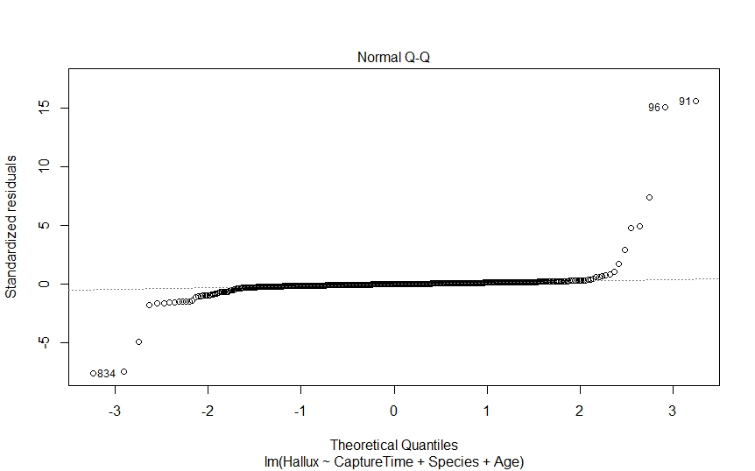
Deployment/Results cont.
Regression plot of capture time, age, and species of hawks vs the hallux
A regression model was built for capture time, age, and species of hawks versus the hallux variable. A table was first created for the three different variables: capture time, species, and age, followed by a regression model being constructed with the hallux variable against the factors: capture time, species, and age. A projection of the summary of the regression model was portrayed while an observation of the confidence intervals of the model was presented as well. Lastly, various plots were exhibited based off the regression model. The performance on the model built was highly inaccurate consequently having no relationship between the three variables versus the hallux column in the hawks data set.

Slide 20
Summary & Conclusions
Since the hawks dataset is structurally formatted in a way where there is some data preparation or wrangling that needs to be done, the more legwork will be building the models based off the business questions proposed to the business problem of which measurements contribute to the survival of the winged animal. Following the CRISP-DM process, after the models have been built, a performance check of whether the models are up to par for answering the business problem will be administered.

Slide 21
Summary & Conclusions cont.
For the first question, the Red-tailed hawk was the most species of hawks that grew to adulthood. For the second question, the Cooper’s hawk was the most species of hawks to participate in migration in the month of November. For the third question, the Red-tailed hawk was the most species of hawks with the lengthier hallux (or killing talon). Finally, the last question deemed invalid, indicating that capture time has nothing to do with the age (adult or immature) of a species of hawks versus the hallux.

Slide 22
Summary & Conclusions cont.
Lastly, an understanding of what the data analysis of the hawks dataset will be executed. This data analysis on a data set known as hawks was not subpar to perform, yet it has a lot of bias. Due to the Red-tailed hawk being the most common species of hawks in the Western Hemisphere, there was a more abundant amount of test subjects or observations within the dataset for that specific species of hawks, thus, translating to a partiality of the Red-tailed hawk over the other two species of hawks as it pertains to the business questions based off the business problem. Although, the age and the hallux of a hawk contribute the most to survival of a species of hawks.

Slide 23
References
Cooper’s hawk. (n.d.). Cooper's hawk - Wikipedia
Hawk. (n.d.). Retrieved from Hawk - Description, Habitat, Image, Diet, and Interesting Facts (animals.net)
Identification of Small Accipiters Sharp-shinned Hawk vs. Cooper’s Hawk. (n.d.). Retrieved from Coopers Hawk vs. Sharp-Shinned Hawk Identification (birdwatching-bliss.com)
Lund, N. (2015, September 18). A Beginner’s Guide to IDing Cooper’s and Sharp-Shinned Hawks. A Beginner’s Guide to IDing Cooper’s and Sharp-Shinned Hawks | Audubon. Audubon.
Measurements on Three Hawk Species. (n.d.). Retrieved from R: Measurements on Three Hawk Species (vincentarelbundock.github.io)
Red-tailed hawk. (n.d.). Retrieved from Red-tailed hawk - Wikipedia
Rosemary. (2014, September 3). Know Your Hawks. Know Your Hawks | Your Great Outdoors (massaudubon.org). Massa Audubon.
Sharp-shinned Hawk. (n.d.). Retrieved from Sharp-shinned Hawk Identification, All About Birds, Cornell Lab of Ornithology
Sharp-shinned hawk. (n.d.). Retrieved from Sharp-shinned hawk – Wikipedia
Stiteler, S. (2016). Six Quick Questions to Help You Identify Red-Tailed Hawks. Six Quick Questions to Help You Identify Red-Tailed Hawks | Audubon. Audubon.
What Eats Hawks: [The Shocking Truth]. (n.d.). Retrieved from What Eats Hawks: [The Shocking Truth] (woodsmanreport.com)

Slide 24
Appendices
Appendix A
Hawk
The article glosses over what a hawk is and partially compares them to eagles and owls. It further describes the descriptions of a hawk as well as provides interesting facts about different hawk species. It continues with the habitat of a hawk, the distribution of them, and their diet. The next topics discussed were about hawks and their interaction with humans as well as domestication and should a hawk be a pet. The last subjects were about the keeping of a hawk, their behavior, and the reproduction of the animal.
Appendix B
What Eats Hawks: [The Shocking Truth]
The article discusses what eat hawks followed by a hawk's location as related to its natural prey and predators. It continues about the hawk being considered top of the food chain for birds of prey with their eggs only being liable. It concludes with pertinent facts about the hawk.

